Slide 1
DOM Traversing and AJAX
By:
Parul Madan(AP)
Computer Science

Slide 2
What is Traversing in jQuery?
jQuery traversing, which means "move through”.Start with one selection and move through that selection until you reach the elements you desire.

Slide 3
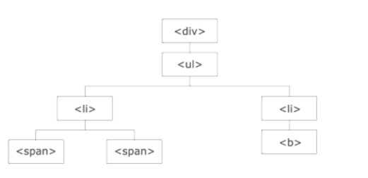
Traversing in jQuery
The <div> element is the parent of <ul>, and an ancestor of everything inside of it
The <ul> element is the parent of both <li> elements, and a child of <div>
The left <li> element is the parent of <span>, child of <ul> and a descendant of <div>
The <span> element is a child of the left <li> and a descendant of <ul> and <div>
The two <li> elements are siblings (they share the same parent)
The right <li> element is the parent of <b>, child of <ul> and a descendant of <div>
The <b> element is a child of the right <li> and a descendant of <ul> and <div>

Slide 4
Traversing Up the DOM Tree
<div class="ancestors">
<div style="width:500px;">div (great-grandparent)
<ul>ul (grandparent)
<li>li (direct parent)
<span>span</span>
</li>
</ul>
</div>
<div style="width:500px;">div (grandparent)
<p>p (direct parent)
<span>span</span>
</p>
</div>
</div>
<script>
$(document).ready(function(){
$("span").parentsUntil("div").css({"color": "red", "border": "2px solid red"});
});
</script>
parent(): method returns the direct parent element of the selected element.
parents():method returns all ancestor elements of the selected element, all the way up to the document's root element (<html>).
parentsUntil():The parents Until() method returns all ancestor elements between two given arguments.

Slide 5
Traversing Down the DOM Tree
children():method returns all direct children of the selected element.
find(): method returns descendant elements of the selected element, all the way down to the last descendant.
<div class="descendants" style="width:500px;">div (current element)
<p class="first">p (child)
<span>span (grandchild)</span>
</p>
<p class="second">p (child)
<span>span (grandchild)</span>
</p>
</div>
<script>
$(document).ready(function(){
$("div").find("span").css({"color": "red", "border": "2px solid red"});
});
</script>

Slide 6
Traversing Sideways in The DOM Tree
siblings():method returns all sibling elements of the selected element.
next(): method returns the next sibling element of the selected element.
nextAll():method returns all next sibling elements of the selected element.
nextUntil():method returns all next sibling elements between two given arguments.
prev()
prevAll()
prevUntil()

Slide 7
jQuery Traversing - Filtering
first(), last() and eq(), which allow you to select a specific element based on its position in a group of elements.
filter() and not() allow you to select elements that match, or do not match, a certain criteria.

Slide 8
What is AJAX?
AJAX is about loading data in the background and display it on the webpage, without reloading the whole page.
For eg: Gmail, Google Maps, Youtube, and Facebook tabs etc.
NOTE: With the jQuery AJAX methods, you can request text, HTML, XML, or JSON from a remote server using both HTTP Get and HTTP Post - And you can load the external data directly into the selected HTML elements of your web page!

Slide 9
jQuery load() Method
The load() method loads data from a server and puts the returned data into the selected element.
Syntax:
$(selector).load(URL , data ,callback);
<script>
$(document).ready(function(){
$("button").click(function(){
$("#div1").load("demo.txt", function(responseText, statusTxt, xhr){
if(statusTxt == "success")
alert("External content loaded successfully!");
if(statusTxt == "error")
alert("Error: " + xhr.status + ": " + xhr.statusText);
});
});
});
</script>
<div id="div1"><h2>XXXXXXXXXXXXXXXXXX</h2></div>

Slide 10
$get() and $post()
The $.get() method requests data from the server with an HTTP GET request.
$.get(URL,callback);
$.post() method requests data from the server using an HTTP POST request.
$.post(URL,data,callback);

